Slide 1
Foundations of Modern Software Systems
Module-2
Instructor: Piyush Goel
N.M.A.M. Institute of Technology

Slide 2
Recap- Module-1

Slide 3
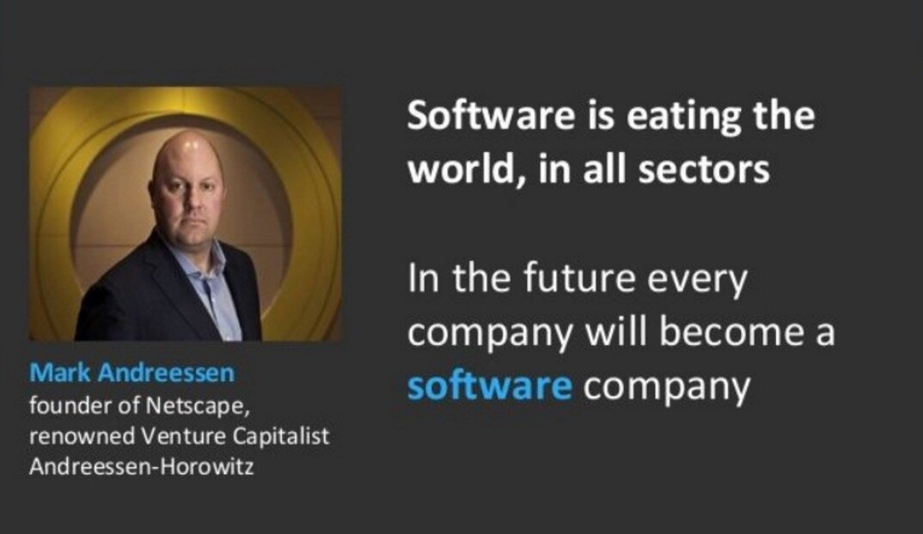
Software has taken over the world & our daily lives.
* https://a16z.com/
* https://en.wikipedia.org/wiki/Marc_Andreessen

Slide 4
Building Blocks (Abstract)
Storage
Compute
Networking & Security

Slide 5
Building Blocks (Abstract)
Storage
Compute
Networking & Security
Data Structures and Algorithms

Slide 6
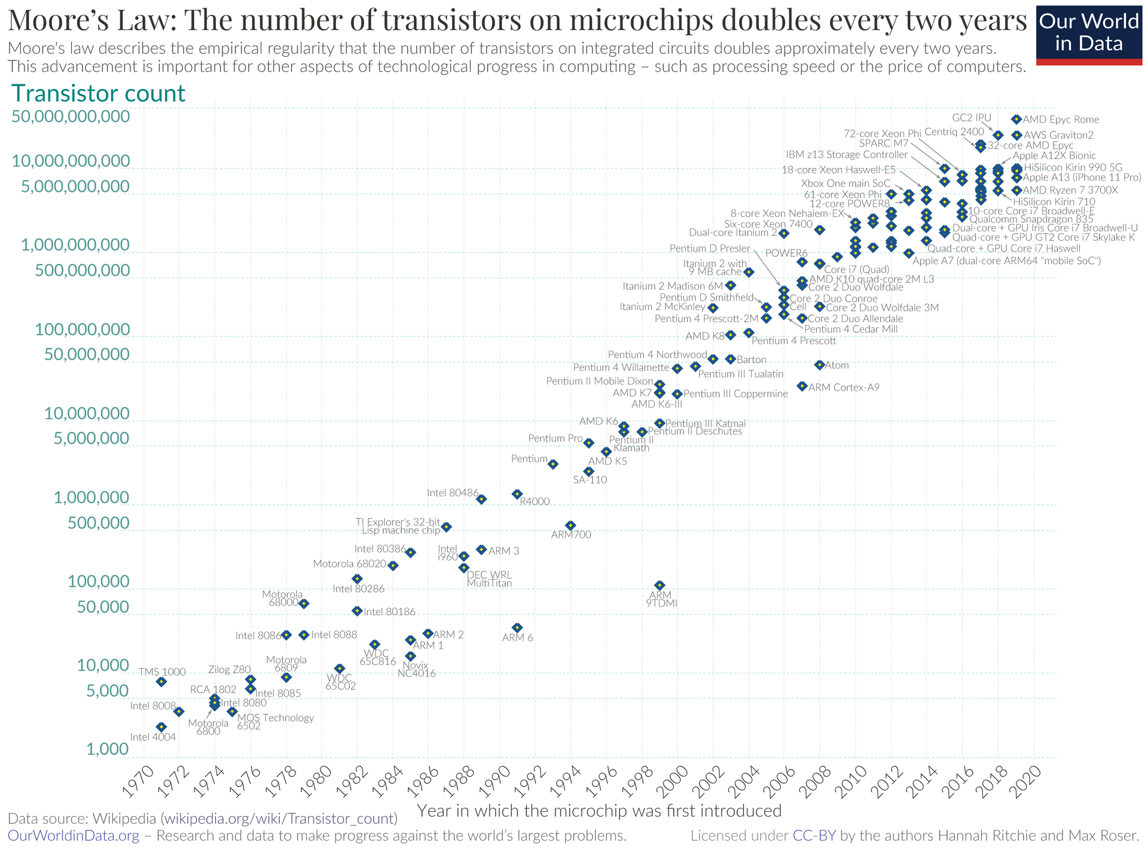
Building Blocks - Compute - Moore’s Law
The number of transistors on computer chips doubles approximately every two years.
Gordon Moore, Founder of Intel

Slide 7
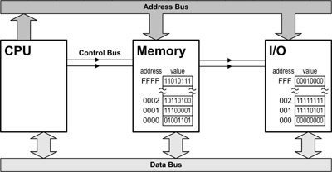
Understanding the Interplay of CPU, Memory, I/O is the holy grail of great software engineering!

Slide 8
Structure of the Course
Module-3: Compute
Process, Threads, Memory.
Servers, Virtual Machines, and Containers.
Application Servers (Web Servers, FTP, Email)
Cloud Computing Basics.
Module-4: Networking
Building Blocks (OSI Layer Models, Network Topologies, Subnets, VPNs, etc.)
Naming Systems (DNS)
Important Protocols
TCP/UDP
HTTP
Web Sockets
Network Security (SSL/TLS)
Other Security Models (Zero-Trust, etc.)
Module-1: Introduction
Module-2: Storage
Basics (Data Types)
Data Storage Fundamentals
Structuring & Querying
Databases
Types
Data Schemas
Object Storage
* We will have a few guest lectures from the other industry experts.

Slide 9
Module-2: Storage

Slide 10
Storage: Data Types
Why is it important to understand the Data Types?

Slide 11
Storage: Data Types
Numbers
Integers
Signed
Unsigned
Decimals
Low Precision
High Precision
Characters
Enums*
Boolean
Primitive Types. Found in most languages, and storage systems.
* Enum is not really a primitive!

Slide 12
Storage: Data Types
Numbers
Integers
Signed
Unsigned
Decimals
Low Precision
High Precision
Characters
Enums
Boolean
Function
Array
Pointer
Reference
Class
Structure
Union
Dictionary
Strings
Tuples
List
Set
Complex Number
Byte
Int
Array
Short
String
Set
List
Question: How would I store a Boolean? How many bytes do I need to store a boolean value?

Slide 13
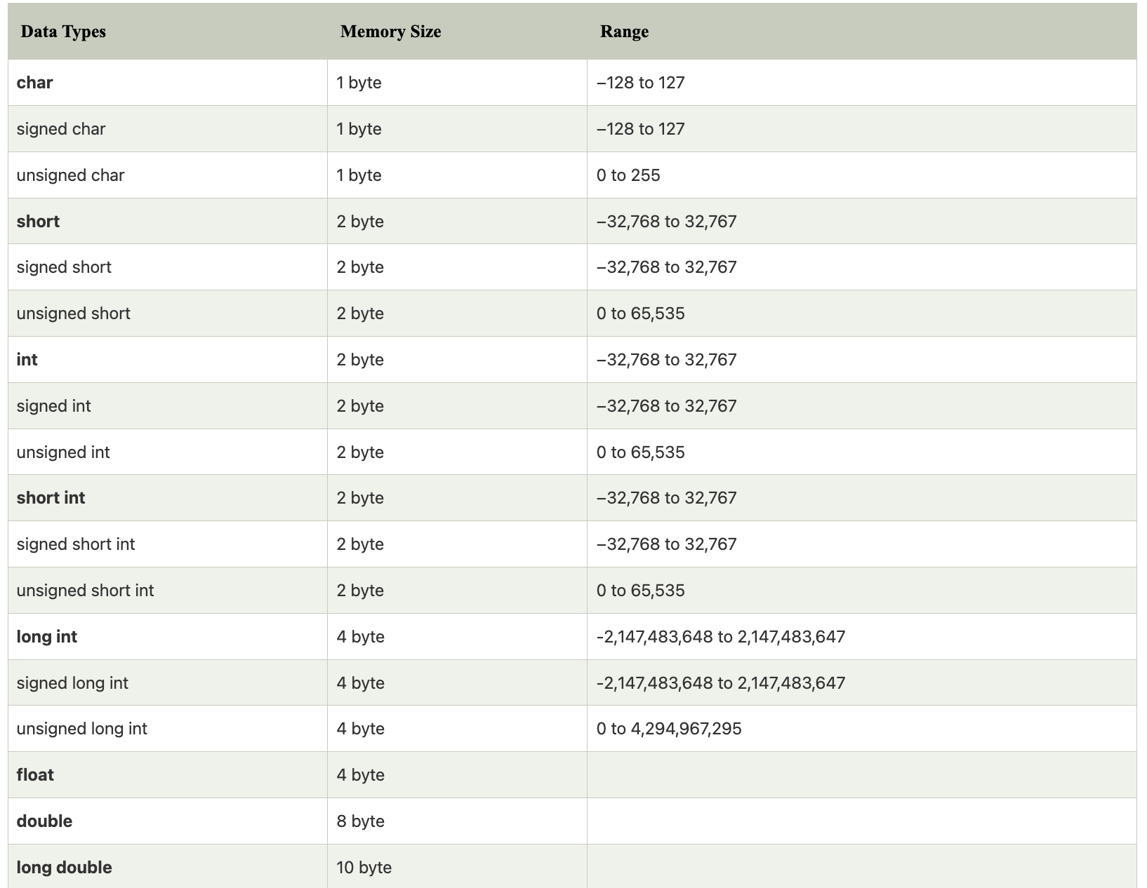
Data types and their sizes in C

Slide 14
int8_t
int16_t
int32_t
uint8_t
uint16_t
uint32_t
What are these data types?

Slide 15
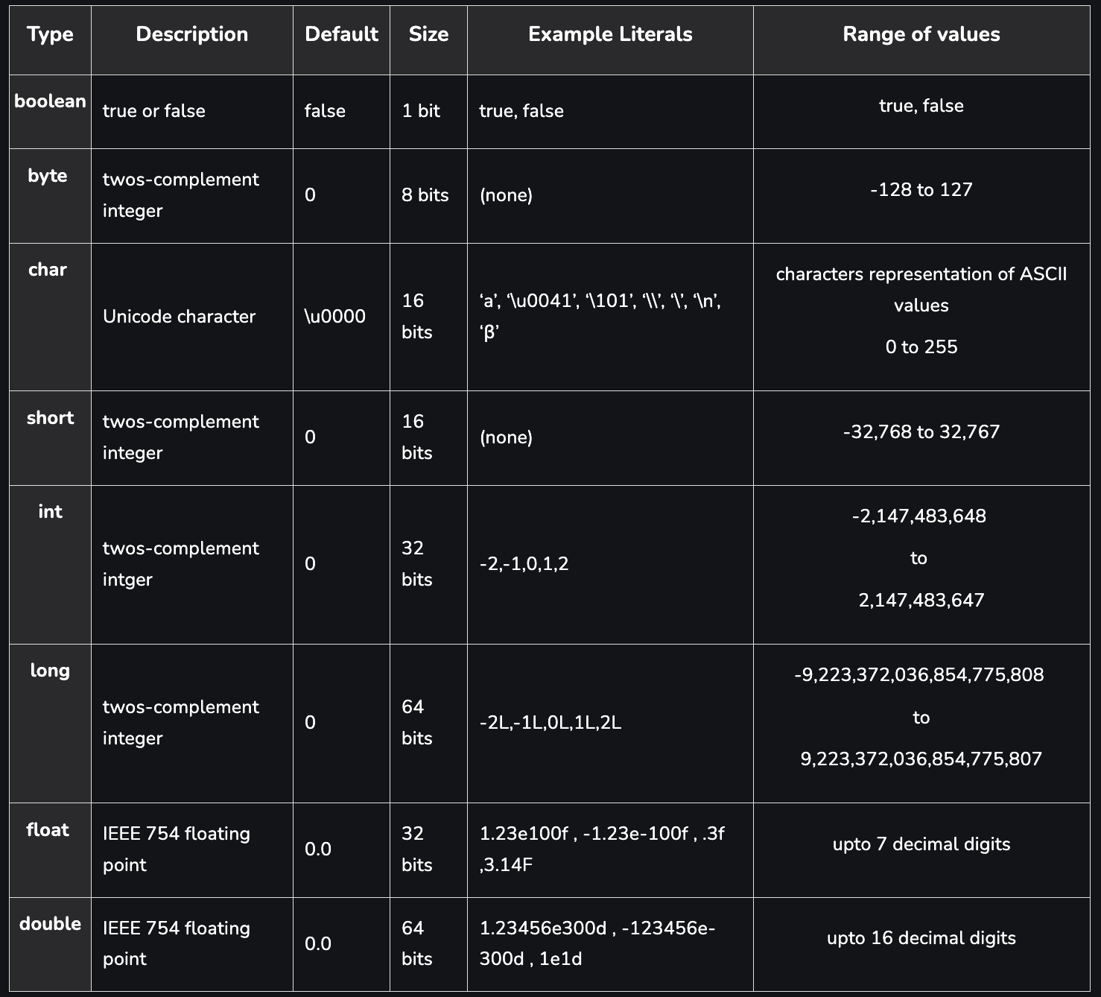
Data types and their sizes in Java

Slide 16
Questions - 1: Decimals
What is single-precision and double-precision for decimals?
What could be an impact of incorrect precision or round-off?
Watched the movie “Office Space?
Rockets can explode? :))
IEEE-754 - Do Read this.
What type of use-cases need high precision Decimals?

Slide 17
Questions - 2: Strings
How many bytes do I need to store Strings?
How do I store non-Latin or non-English characters?
Character Sets
Unicode
Encodings
Variable Length Character Encodings (UTF-8)
Lang and Locale
Practical Example - Zomato
Ever heard of Mojibake?
How do I sort similar looking characters? (A vs Ä)
Collation

Slide 18
Questions - 3: Time
How do I represent Time?
MySQL has 4 different data-types
Date
Time
DateTime
Timestamp
Year
What about Timezones?

Slide 19
Questions - 4: Binary Objects
How do I store random binary objects?
Music files
Images
PDF files
Homework: Try to store a PDF file or a JPEG Image in a MySQL database.

Slide 20
Data Types: Storage Systems
MySQL - https://dev.mysql.com/doc/refman/8.0/en/data-types.html
MongoDB - https://www.mongodb.com/docs/mongodb-shell/reference/data-types/
SQLite - https://www.sqlite.org/datatype3.html

Slide 21
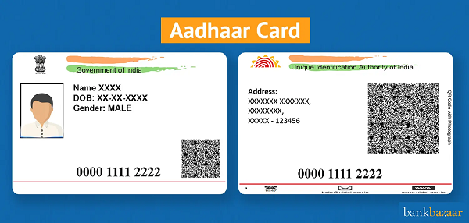
Data Types: Simple Exercise
What would be the data types for representing the fields of an Aadhar Card?

Slide 22
What databases are used by Aadhar Card System?

Slide 23
What databases are used by Aadhar Card System?
Homework =)

Slide 24
Storage - Fundamentals
File Systems
Serialisation
Compression
Ad-hoc things.

Slide 25
Storage - Fundamentals - File Systems
Why do we need File Systems?

Slide 26
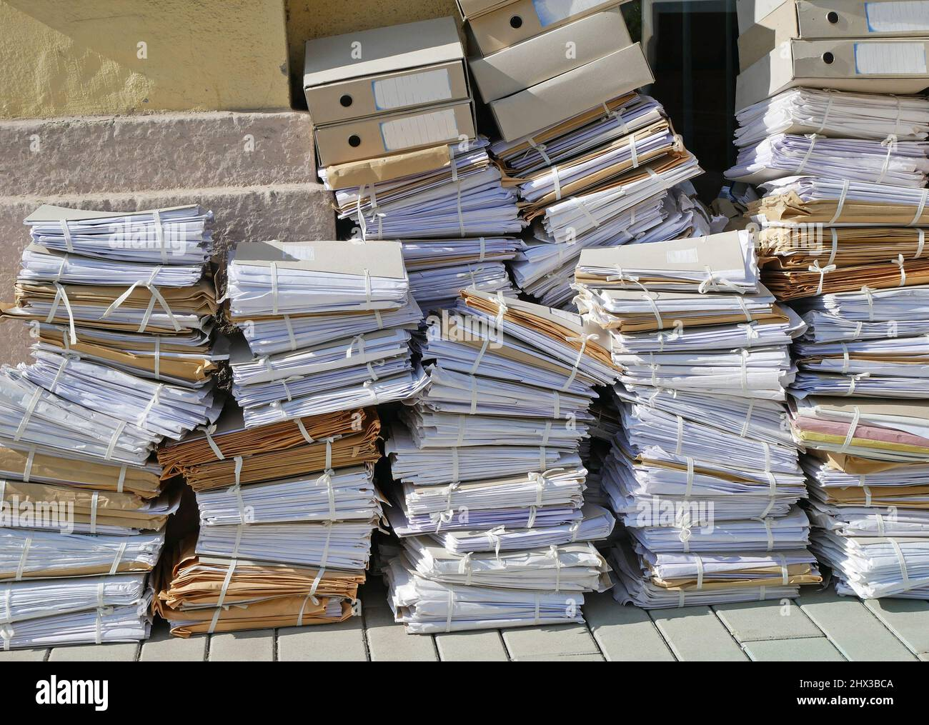
Storage - Fundamentals - File Systems
Why do we need File Systems?

Slide 27
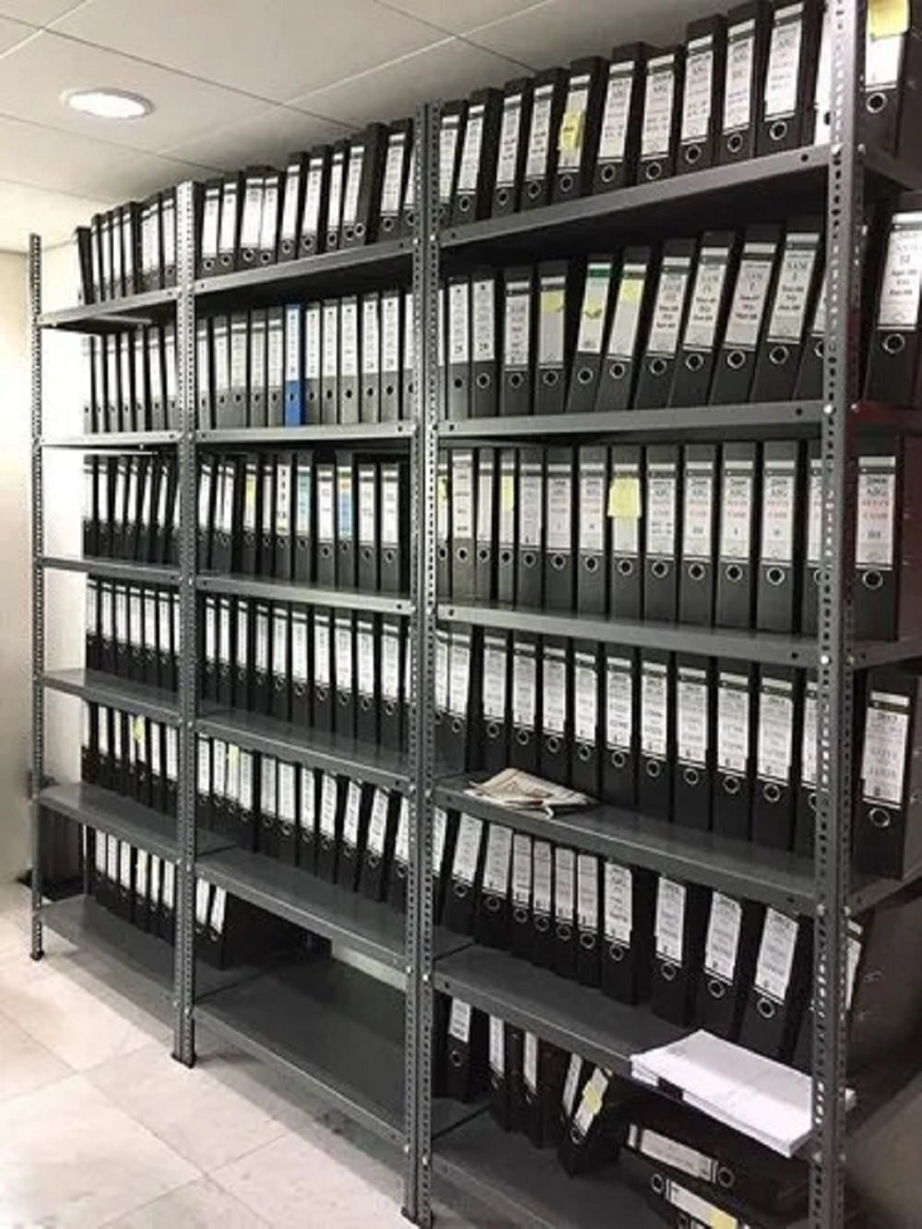
Storage - Fundamentals - File Systems
Why do we need File Systems?

Slide 28
Storage - Fundamentals - File Systems
Space Management: Raw Blocks converted to usable units.
Naming Convention
Organisation
Directories
Metadata
Security
Permissions
Read
Write
Executable
Integrity
File Formats
Great Resource - https://docs.fileformat.com/

Slide 29
Storage - Fundamentals - File Systems
Popular File Systems:
Windows - FAT/FAT32
Linux/Unix - EXT2/EXT3/EXT4

Slide 30
Storage - Fundamentals - File Systems
What if I want a more reliable and high concurrency/throughput from my file system?
Billions of Files - Think about all the photos we click?
Petabytes of Storage - Think about all the movies that have to be stored?
Data Corruption - What if my hard-disk gets corrupted or damaged?
Thousands of Users - Think about concurrency/throughput if everyone in the room
wants to watch a single movie at the same time?

Slide 31
Storage - Fundamentals - File Systems
Distributed File Systems:
Google - Google File System (GFS)
Yahoo - Hadoop Distributed File System (HDFS)
https://www.youtube.com/watch?v=vdkx2xasGlM&ab_channel=Udacity
https://www.youtube.com/watch?v=4Gfl0WuONMY&ab_channel=InfoQ

Slide 32
Questions

